Slide 1
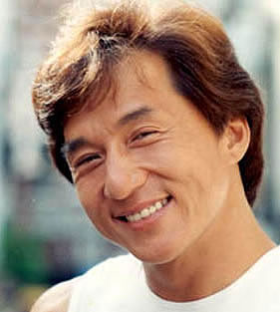
请你描述一下成龙的长相？他的眼睛大不大？他的脸很方还是很圆？嘴巴很小吗？鼻子呢？耳朵呢？眉毛呢？
Source 1

Slide 2
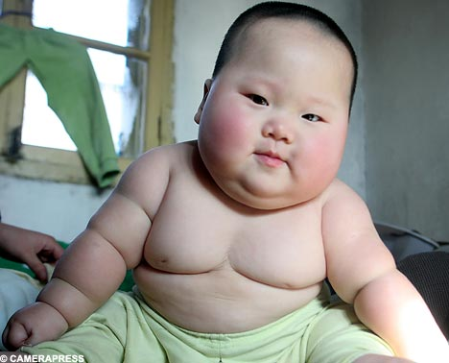
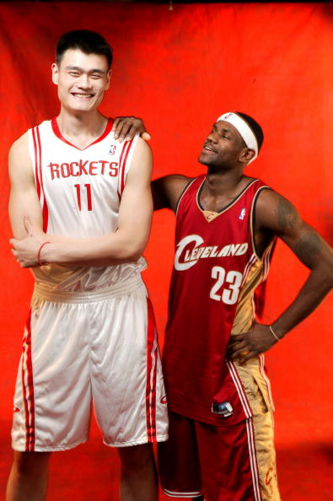
他长得很高吗？他长得很矮吗？ 她长得很瘦吗？他长得很胖吗？
Source 6
Source 5
Source 7

Slide 3
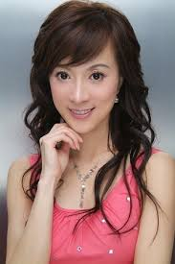
她的头发很长还是很短？ 她的眉毛黑不黑？浓不浓？ 你的眉毛黑不黑？ 谁的眉毛又黑又浓？
Source 8

Slide 4
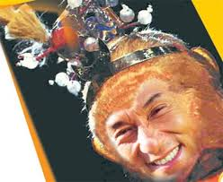
你觉得成龙看起来很成熟还是很幼稚？他显得很幼稚吗？
Source 2

Slide 5
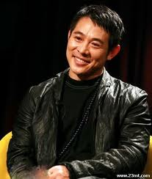
你觉得谁长得很英俊？ 谁长得很帅？谁会吸引你？ 他的什么吸引了你？
Source 3
Source 4

Slide 6
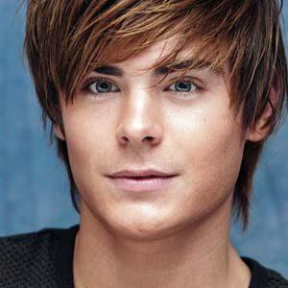
请你描述这两个人。 她的眼镜吸引了你吗？他的眼睛吸引了你吗？他/她的什么吸引了你？
Source 10
Source 9

Slide 7
Picture Citations and Sources
Source 1 https://www.google.com/search?hl=en&site=imghp&tbm=isch&source=hp&biw=1280&bih=899&q=%E6%88%90%E9%BE%99&oq=%E6%88%90%E9%BE%99&gs_l=img.12..0l10.2318.6842.0.10387.23.8.13.2.2.0.81.566.8.8.0....0.0..1ac.1j4.20.img.uNjlz2vuyzA#facrc=_&imgdii=_&imgrc=GGDmv94hkoGzfM%3A%3Bxffx_O4uS_OQ1M%3Bhttp%253A%252F%252Fnews.xinhuanet.com%252Fent%252F2007-11%252F22%252Fxin_04211042208536561946814.jpg%3Bhttp%253A%252F%252Fnews.xinhuanet.com%252Fent%252F2007-11%252F22%252Fcontent_7124294.htm%3B281%3B313
Source 2 https://www.google.com/search?hl=en&site=imghp&tbm=isch&source=hp&biw=1280&bih=899&q=%E6%88%90%E9%BE%99&oq=%E6%88%90%E9%BE%99&gs_l=img.1.0.0l10.3568.5274.0.7254.10.8.0.2.2.0.76.378.8.8.0....0.0..1ac.1j4.20.img.13MzRqHwSs0#facrc=_&imgdii=_&imgrc=ULO1vJAZVoginM%3A%3B0kbdSWjrq6DNRM%3Bhttp%253A%252F%252Fmyarticle.enet.com.cn%252Fimages%252F2006%252F1020%252F1161303221228.jpg%3Bhttp%253A%252F%252Fwww.enet.com.cn%252Flife%252Fent%252Fylzb%252F200610%252F20061020155049_1.shtml%3B400%3B327
Source 3 https://www.google.com/search?hl=en&site=imghp&tbm=isch&source=hp&biw=1280&bih=899&q=%E5%91%A8%E6%9D%B0%E4%BC%A6&oq=%E5%91%A8%E6%9D%B0%E4%BC%A6&gs_l=img.12..0l10.2128.4252.0.8626.11.11.0.0.0.0.92.735.11.11.0....0.0..1ac.1j4.20.img.QB6bkWfsNWI#facrc=_&imgdii=_&imgrc=KNJv4FdKi6ya1M%3A%3BL7dnfJRZij1XrM%3Bhttp%253A%252F%252Fuserserve-ak.last.fm%252Fserve%252F_%252F54165667%252FJay%252BChou.jpg%3Bhttp%253A%252F%252Fwww.last.fm%252Fmusic%252FJay%252BChou%252B%2525E5%252591%2525A8%2525E6%25259D%2525B0%2525E4%2525BC%2525A6%252F%252Bimages%252F54165667%3B330%3B323
Source 4 https://www.google.com/search?hl=en&site=imghp&tbm=isch&source=hp&biw=1280&bih=899&q=%E6%9D%8E%E8%BF%9E%E6%9D%B0&oq=%E6%9D%8E%E8%BF%9E%E6%9D%B0&gs_l=img.1.0.0l6j0i24l3j0i5i2.3878.6521.0.9108.10.10.0.0.0.0.101.701.9j1.10.0....0.0..1ac.1j4.20.img.Gck2OULgugY#facrc=_&imgdii=_&mgrs.=KSq2x5oLcHN0lM%3A%3BZggw5iZQ-wGKvM%3Bhttp%253A%252F%252Fblogfile.ifeng.com%252Fuploadfiles%252Fblog_attachment%252F0807%252F81%252F1324781_131173d21705a211445a8bc8926b89fb.jpg%3Bhttp%253A%252F%252Fblog.ifeng.com%252Farticle%252F1556557.html%3B400%3B472

Slide 8
Source 5：http://news.xinhuanet.com/sports/2007-11/28/xinsrc_5421104281024843152143.jpg
Source 6: http://25.media.tumblr.com/tumblr_m549xehQ5b1qhe03fo1_500.jpg
Source 7: http://clubfiles.liba.com/2012/07/24/21/35482298.jpg
Source 8: http://oepic.oeeee.com/200812/15/90/6434431429356477846.jpg
Source 9: http://x17online.com/jrobertz061009_02_X17.jpg
Source 10: http://2.bp.blogspot.com/_BRLSnbrdixw/TP27vWvRmQI/AAAAAAAAAXg/YL9uSRSXZMU/s320/movie%2Bstars%2Bzac.jpg

